Slide 1
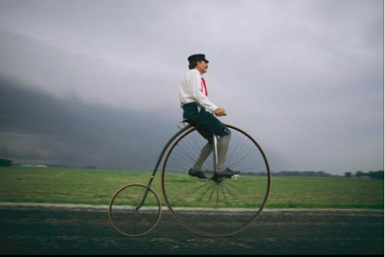
Melissa Farlow

